Slide 1
Online Retail Store DB Design
Lab 3 - Logical and Physical Modelling

Slide 2
Business Definition Table
Entity Name | Description | Relationships
Customer | A person who places orders on the online store | One customer can place many orders One customer can write many reviews
Product | Items sold in the online store | One product can appear in many order items One product can have many reviews One product is linked to one inventory record
Order | Represents a purchase made by a customer | One order belongs to one customer One order can contain multiple order items
OrderItem | Represents individual items in an order | Many order items per order Many order items per product
Inventory | Tracks stock level and reorder thresholds per product | Each product has exactly one inventory record
Review | Feedback given by customers for purchased products | One review per customer per product

Slide 3
Entities and Attributes
Entities | Attributes
Customers | CustomerID (Primary Key) First Name Last Name Email Phone Address
Products | ProductID (Primary Key) Name Category Description Price
Orders | OrderID(Primary Pey) CustomerID(Foreign Key) Order Date Total Amount
OrderItems | OrderItemID (Primary Key) OrderID (Foreign Key) ProductID (Foreign Key) Quantity Subtotal
Inventory | InventoryID (Primary Key) ProductID (Foreign Key) Stock Quantity Reorder Level
Reviews | ReviewID (PK) ProductID (FK) CustomerID (FK) Rating Review Text Review Date

Slide 4
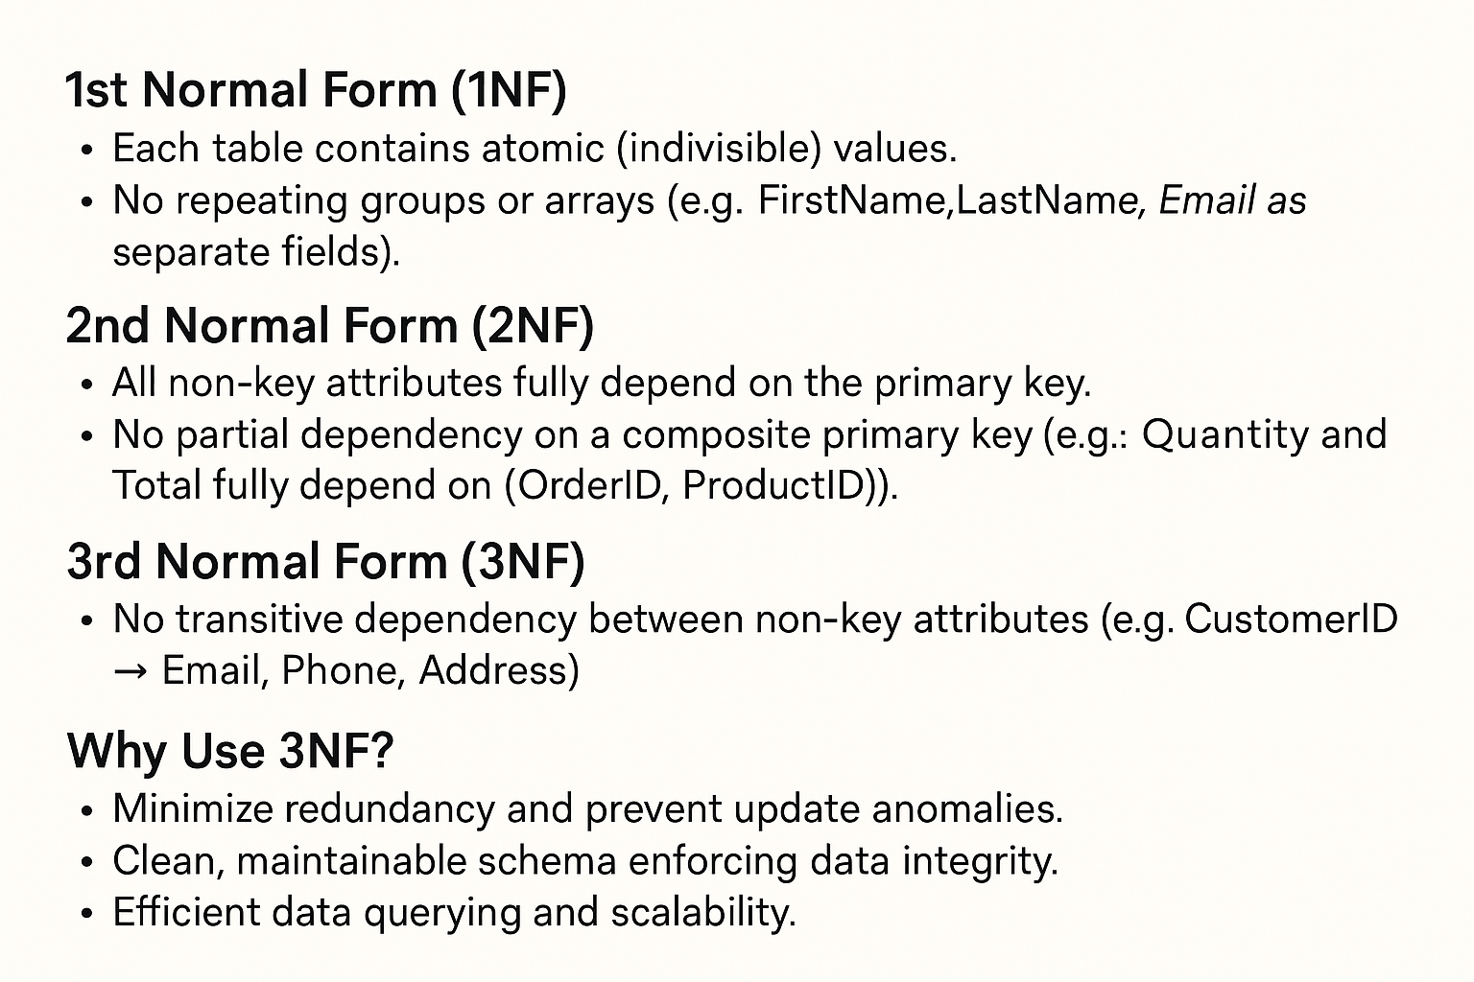
Normalization in Database Design

Slide 5
Relationships (Cardinality):
Customers places Orders (1:N)
Orders contains Order Item (1:N)
Order Item references Products (N:1)
Products has Inventory (1:1)
Products receives Reviews (1:N)
Customers writes Reviews (1:N)

Slide 6
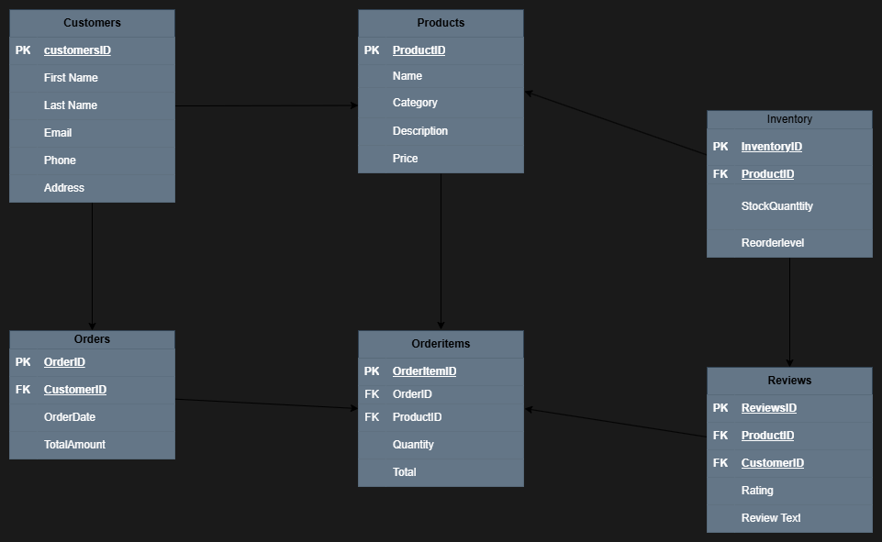
Conceptual ERD

Slide 7
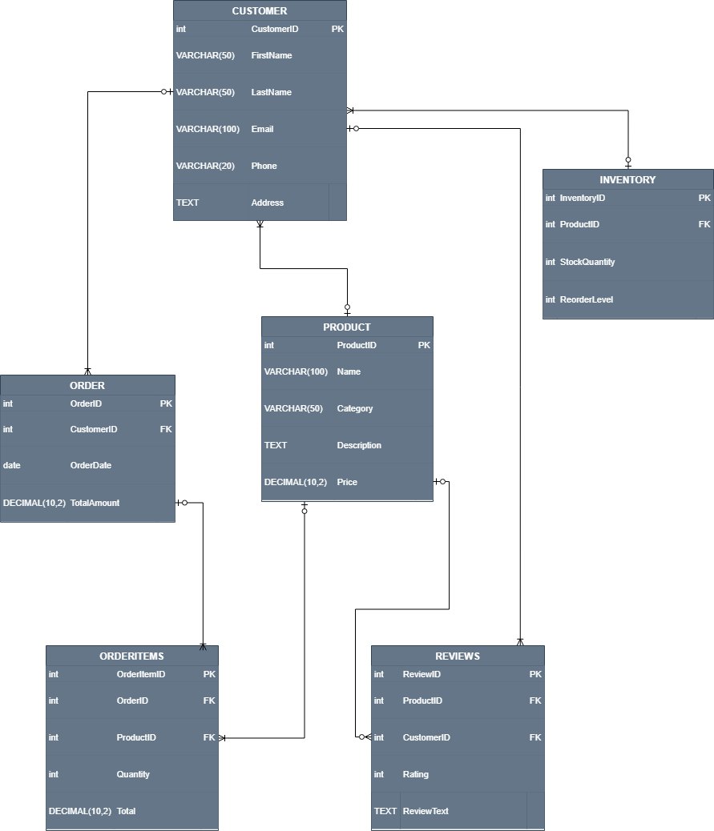
Entity-Relationship Model - PHYSICAL

Slide 8
Physical Database Design
SQL Queries to create tables
CREATE TABLE Customers ( CustomerID INT PRIMARY KEY, FirstName VARCHAR(50), LastName VARCHAR(50), Email VARCHAR(100) UNIQUE, Phone VARCHAR(20), Address TEXT ); | CREATE TABLE OrderItems ( OrderItemID INT PRIMARY KEY, OrderID INT, ProductID INT, Quantity INT, Total DECIMAL(10, 2), FOREIGN KEY (OrderID) REFERENCES Orders(OrderID), FOREIGN KEY (ProductID) REFERENCES Products(ProductID) );
CREATE TABLE Products ( ProductID INT PRIMARY KEY, Name VARCHAR(100), Category VARCHAR(50), Description TEXT, Price DECIMAL(10, 2) ); | CREATE TABLE Inventory ( InventoryID INT PRIMARY KEY, ProductID INT UNIQUE, StockQuantity INT, ReorderLevel INT, FOREIGN KEY (ProductID) REFERENCES Products(ProductID) );
CREATE TABLE Orders ( OrderID INT PRIMARY KEY, CustomerID INT, OrderDate DATE, TotalAmount DECIMAL(10, 2), FOREIGN KEY (CustomerID) REFERENCES Customers(CustomerID) ); | CREATE TABLE Reviews ( ReviewID INT PRIMARY KEY, ProductID INT, CustomerID INT, Rating INT CHECK (Rating >= 1 AND Rating <= 5), ReviewText TEXT, FOREIGN KEY (ProductID) REFERENCES Products(ProductID), FOREIGN KEY (CustomerID) REFERENCES Customers(CustomerID) );

Slide 9
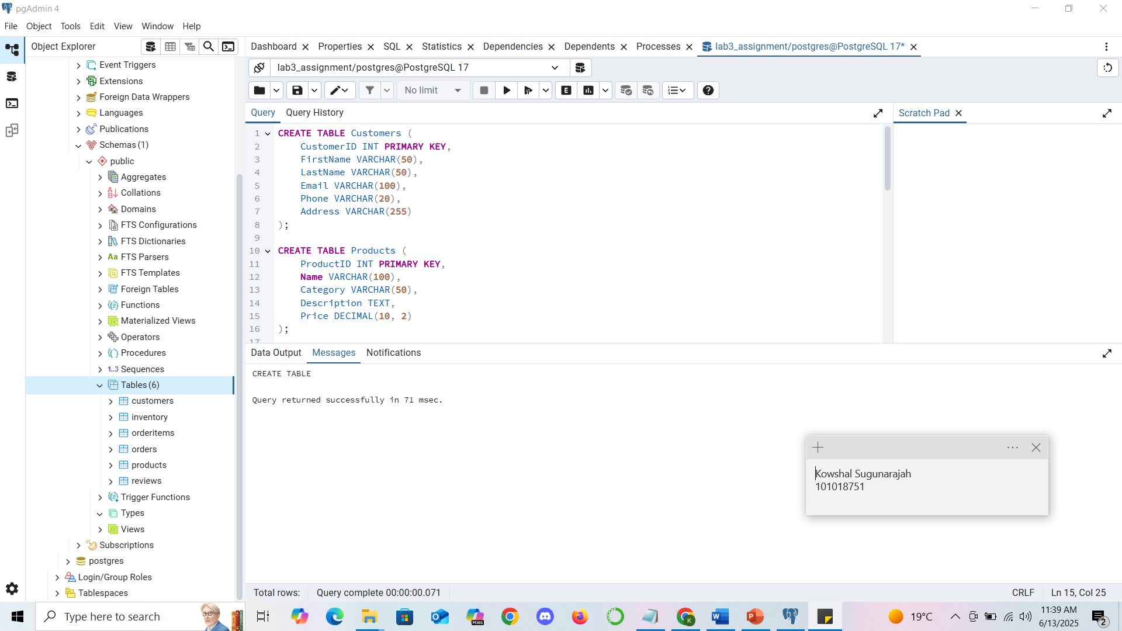
Physical Database Design
SQL Execution:

Slide 10
SQL Queries to insert data into table
INSERT INTO Customers (CustomerID, FirstName, LastName, Email, Phone, Address) VALUES (1, 'Alice', 'Johnson', 'alice.j@email.com', '1234567890', '123 Maple St'), (2, 'Bob', 'Smith', 'bob.s@email.com', '2345678901', '456 Oak Ave'); | INSERT INTO Products (ProductID, Name, Category, Description, Price) VALUES (101, 'Wireless Mouse', 'Electronics', 'Bluetooth ergonomic mouse', 29.99), (102, 'Python Programming Book', 'Books', 'Comprehensive Python guide', 39.99), (103, 'Denim Jacket', 'Clothing', 'Blue denim with classic fit', 59.99);
INSERT INTO Orders (OrderID, CustomerID, OrderDate, TotalAmount) VALUES (1001, 1, '2025-06-01', 69.98), (1002, 2, '2025-06-02', 39.99); | INSERT INTO OrderItems (OrderItemID, OrderID, ProductID, Quantity, Total) VALUES (5001, 1001, 101, 1, 29.99), (5002, 1001, 103, 1, 39.99), (5003, 1002, 102, 1, 39.99);
INSERT INTO Inventory (InventoryID, ProductID, StockQuantity, ReorderLevel) VALUES (9001, 101, 100, 20), (9002, 102, 75, 10), (9003, 103, 50, 5); | INSERT INTO Reviews (ReviewID, ProductID, CustomerID, Rating, ReviewText) VALUES (2001, 101, 1, 5, 'Works perfectly!'), (2002, 102, 2, 4, 'Very informative and helpful.');

Slide 11
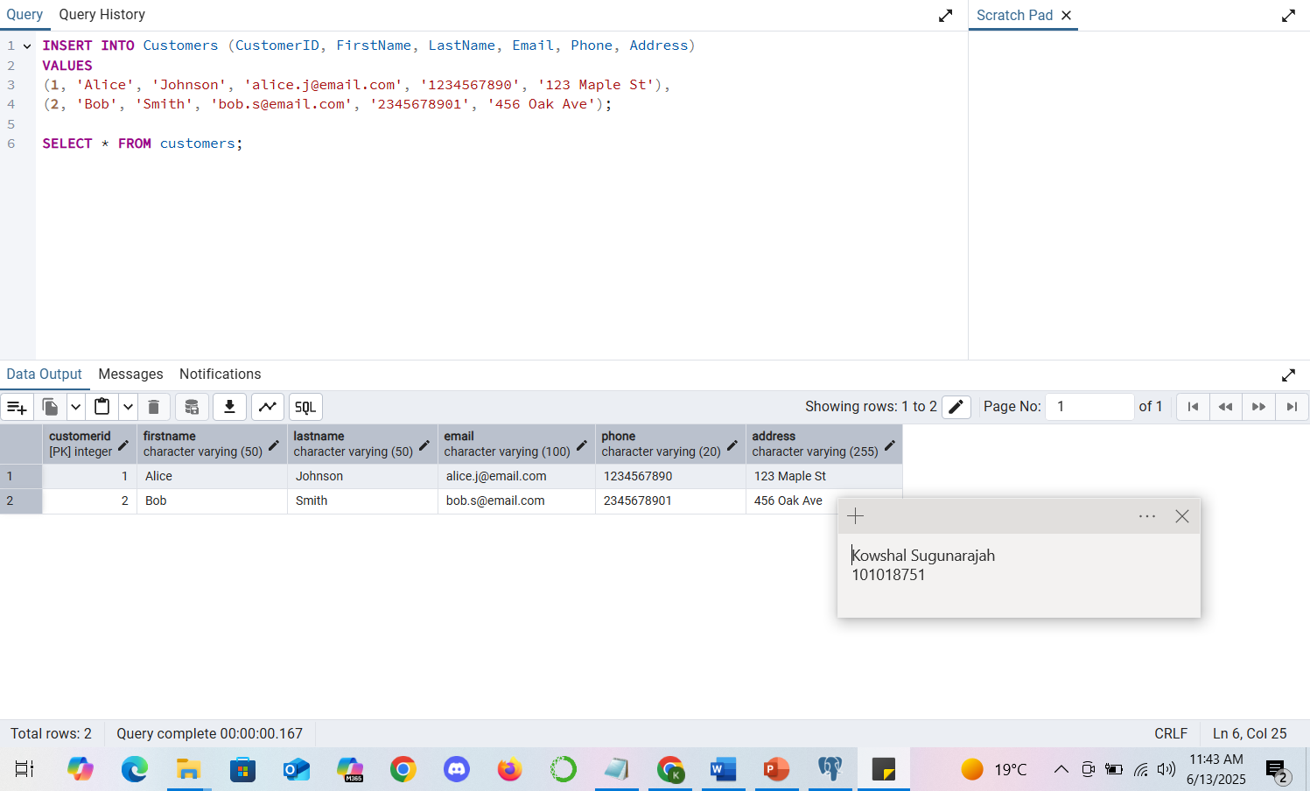
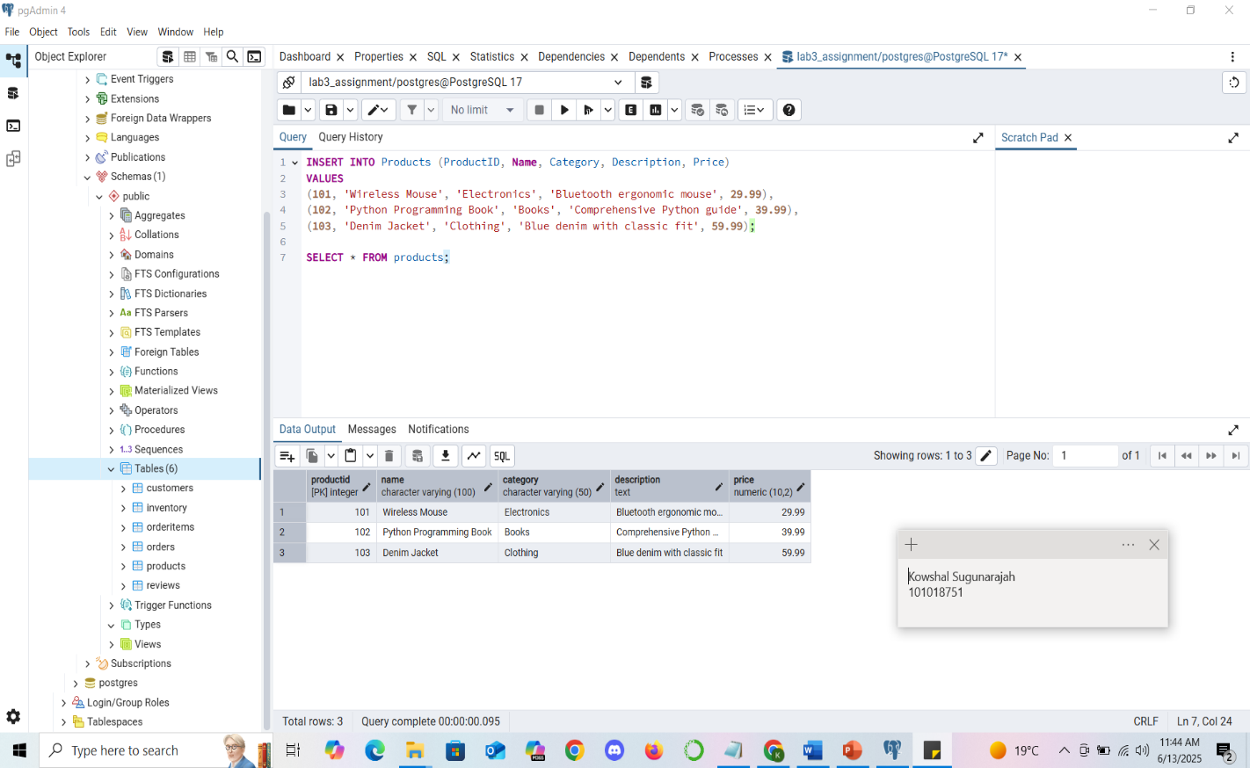
SQL Execution to insert data into table

Slide 12
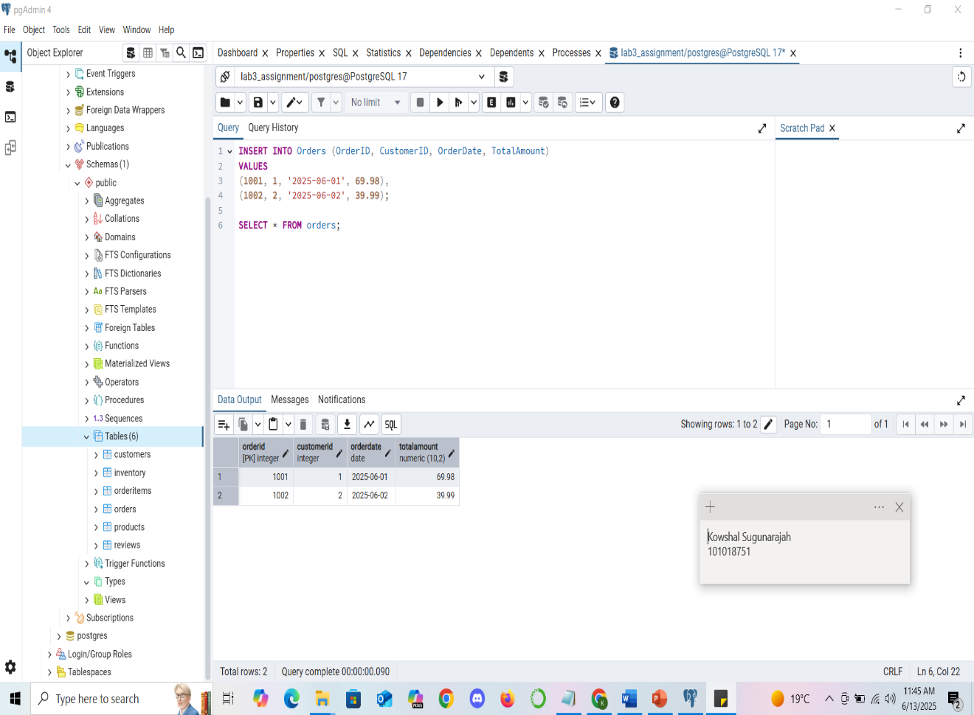
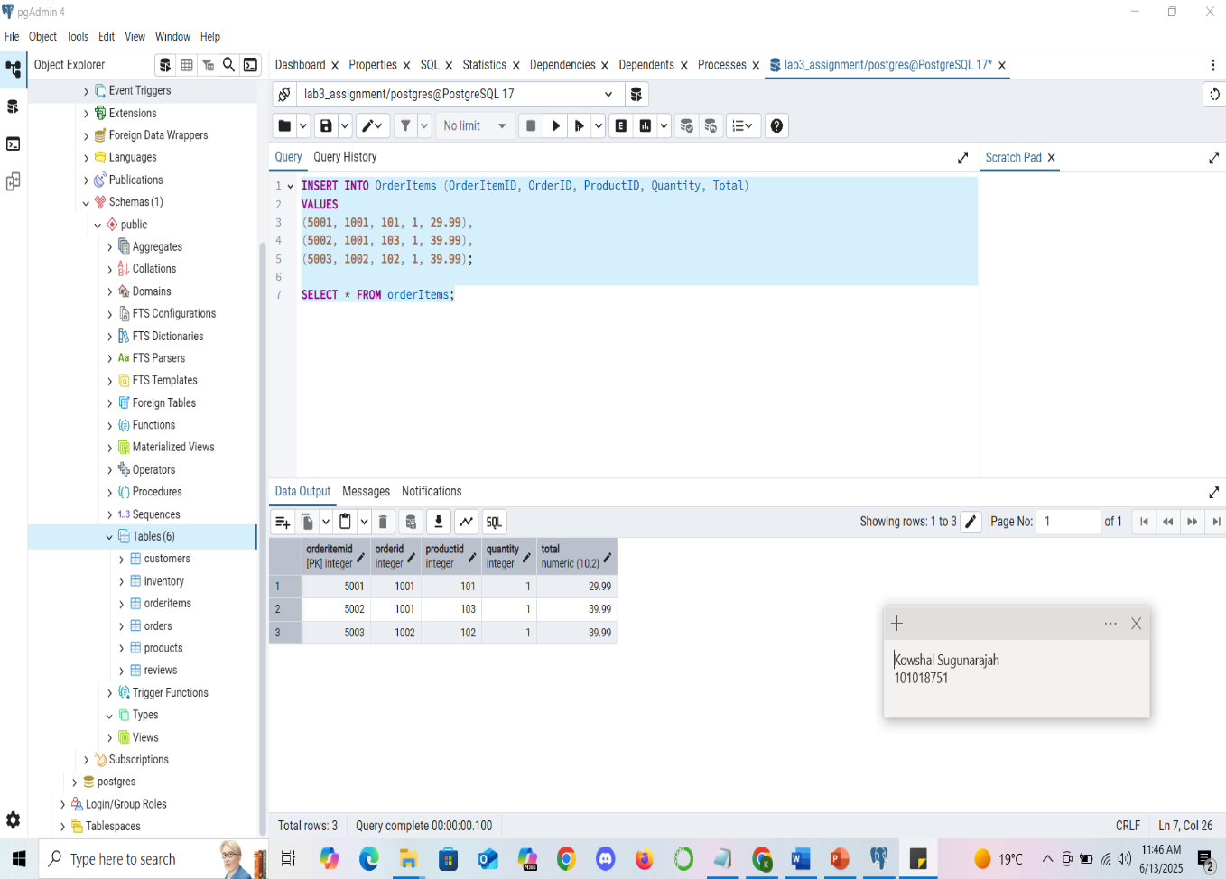
SQL Execution to insert data into table

Slide 13
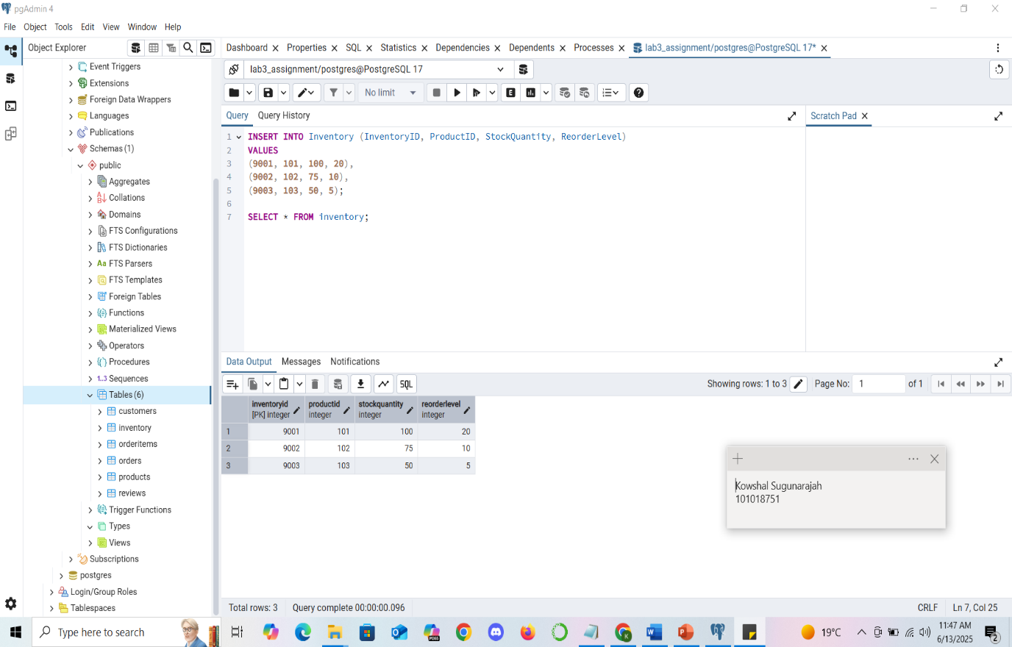
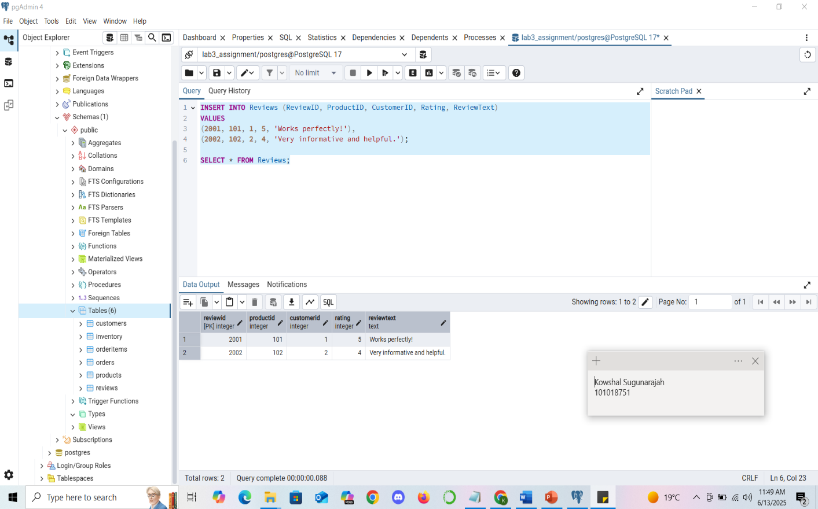
SQL Execution to insert data into table

Slide 14
Validation
Check if all orders are associated with existing customers SELECT o.OrderID FROM Orders o LEFT JOIN Customers c ON o.CustomerID = c.CustomerID WHERE c.CustomerID IS NULL; | b) Find products that have not been reviewed SELECT ProductID, Name FROM Products p LEFT JOIN Reviews r ON p.ProductID = r.ProductID WHERE r.ProductID IS NULL;
c) CREATE OR REPLACE VIEW ProductAverageRatings AS SELECT p.ProductID, p.Name, p.Category, p.Price, AVG(r.Rating) AS AverageRating FROM Products p LEFT JOIN Reviews r ON p.ProductID = r.ProductID GROUP BY p.ProductID, p.Name, p.Category, p.Price; | d) CREATE OR REPLACE VIEW CustomerTotalSpending AS SELECT c.CustomerID, c.FirstName, c.LastName, c.Email, c.Phone, c.Address, COALESCE(SUM(o.TotalAmount), 0) AS TotalSpending FROM Customers c LEFT JOIN Orders o ON c.CustomerID = o.CustomerID GROUP BY c.CustomerID, c.FirstName, c.LastName, c.Email, c.Phone, c.Address;

Slide 15
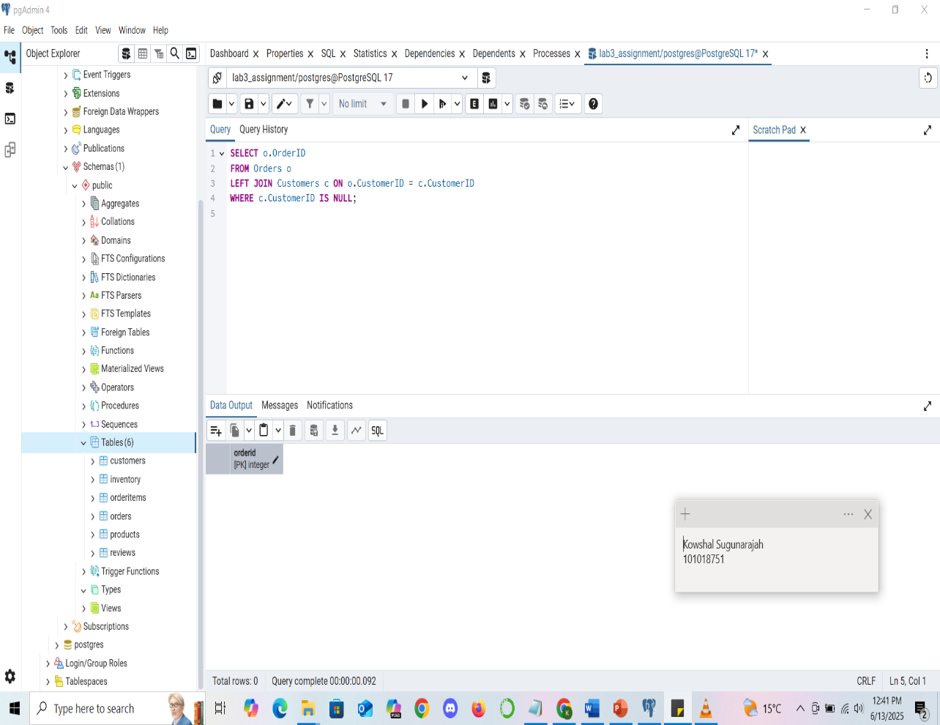
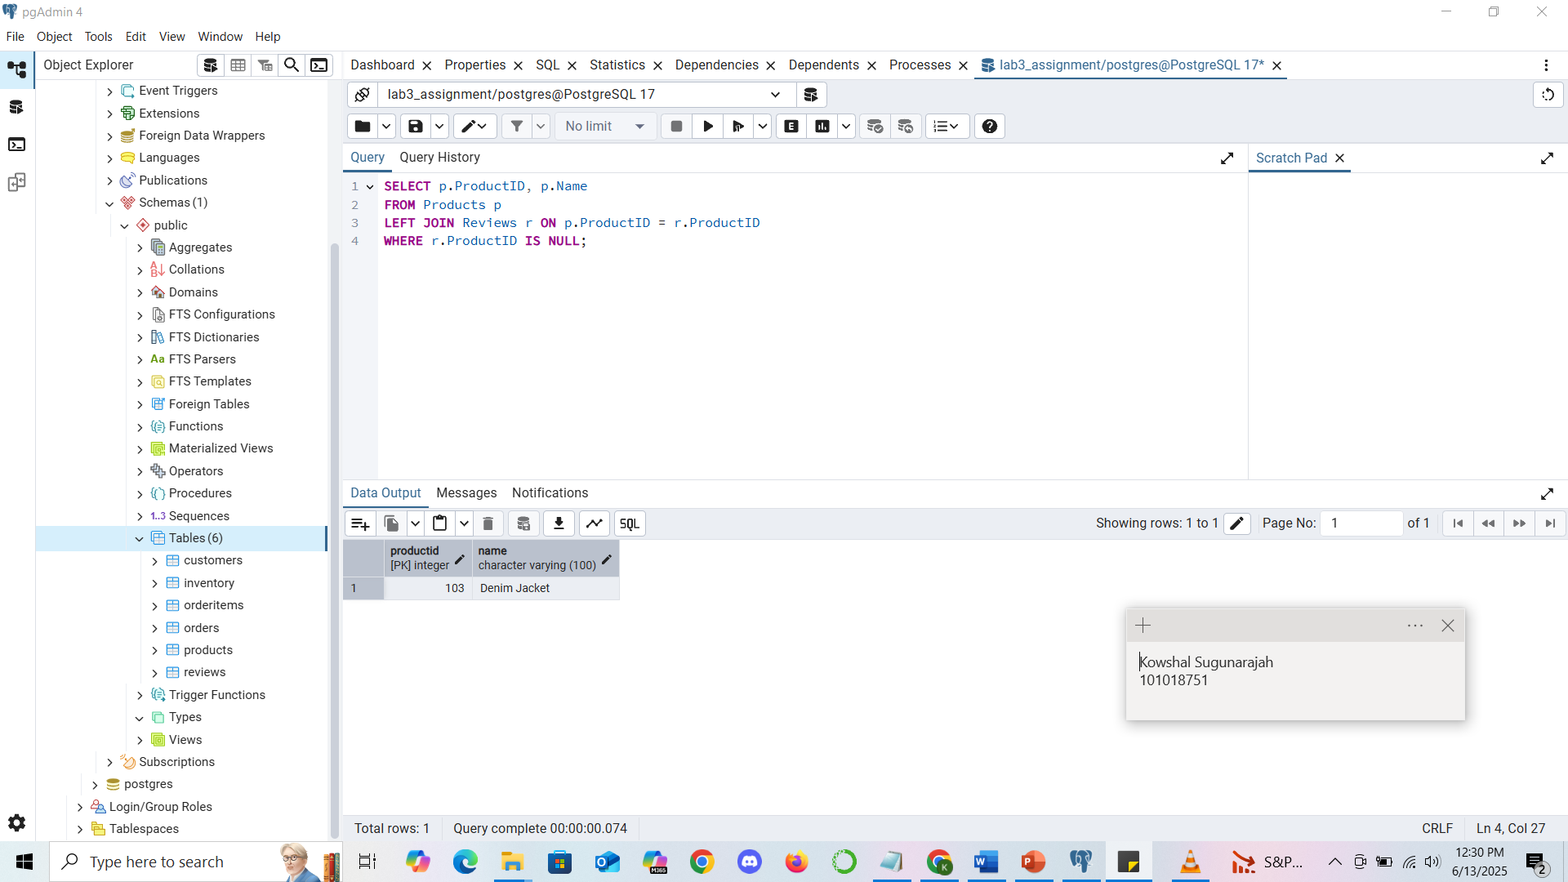
Validation

Slide 16
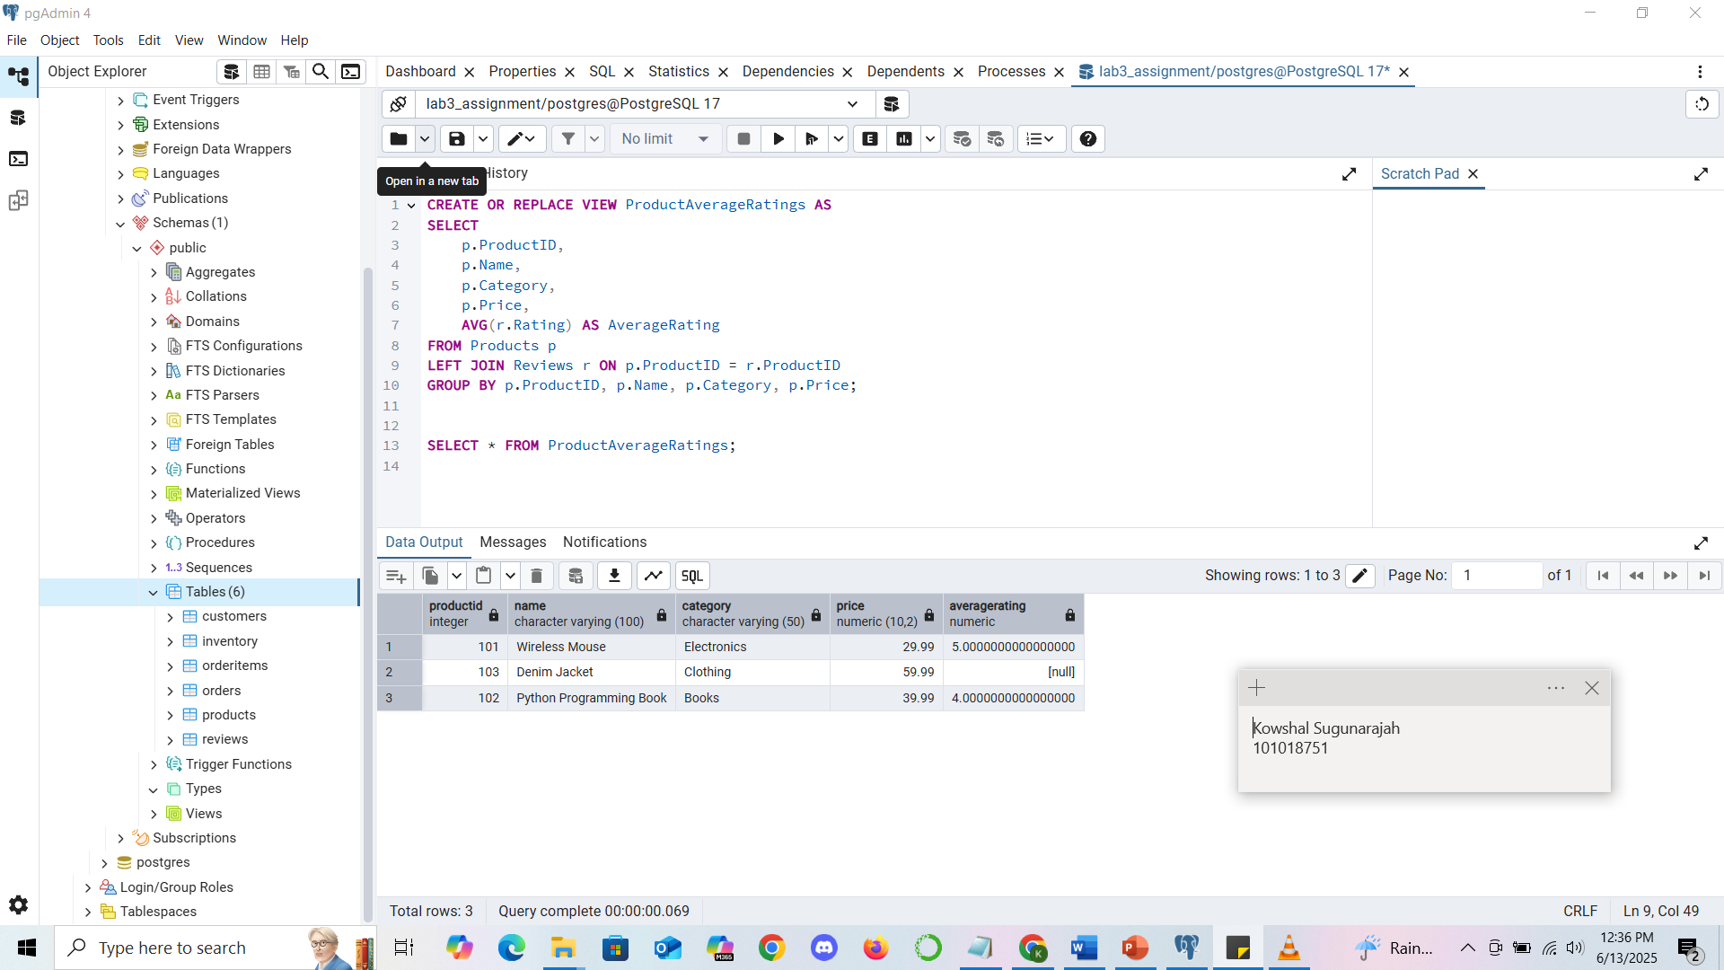
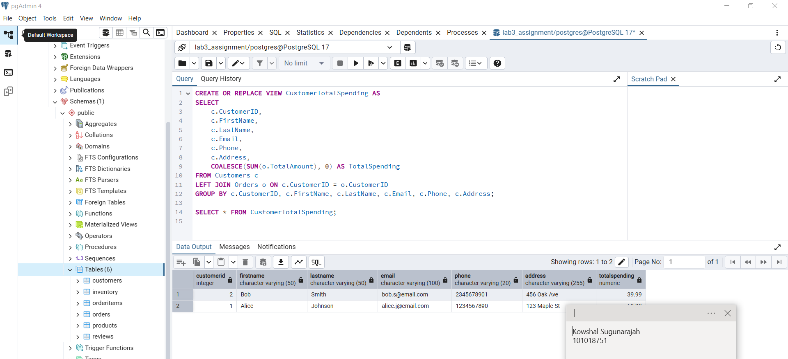
Validation

Slide 17
Thank you

